Slide 1
Tution.media
PITCH · MAY 2026 · V1.1
DHAKA · HYPERLOCAL · TUTOR-FIRST
Match in days, not weeks.
A tutor marketplace that owns the ongoing relationship — and the monthly money flow. Not just the match.
SUPPLY-FIRST
PWA · ANDROID-FIRST
BANGLA · ENGLISH
LAUNCH: 2 DHAKA CLUSTERS
CONFIDENTIAL · TUTION MEDIA
01 / 14

Slide 2
Tution.media
02 · THE OPENING
THE OPENING
Tuition in Dhaka is huge, high-frequency, and untouched by software where it counts.
TUTORS WAITING ON THE INCUMBENT
OF THE MONEY FLOW HAPPENS OFF-PLATFORM
YEARS INCUMBENT HAS HAD TO FIX THIS
2–4wks
~100%
13
From signup to first match. We cut it to days.
Caretutors monetizes once. Then cash leaves the building.
They haven't. We out-engineer and out-focus.
WHY NOW
02 / 14
Notes:
Hello — this is Tution Media. We're building Dhaka's first tutor marketplace that owns the ongoing relationship, not just the match. The incumbent monetizes once at placement, then the tutor and guardian leave the platform. We don't.

Slide 3
Tution.media
03 · THE WEDGE
THE WEDGE
Own the ongoing relationship and the money flow — not just the match.
INCUMBENT · CARETUTORS
TUTION.MEDIA
Match · monetize · move on.
Match · stay · compound.
PLACEMENT FEE ONLY
COMMS LEAVE PLATFORM
NO RECURRING RAILS
RECURRING MONTHLY RAILS
MASKED IN-APP COMMS
VERIFIED REPUTATION
NO ACCOUNTABILITY
PAYMENT PROTECTION
Day 1 they earn. Day 2 onward, value walks out the door — and so does the relationship.
Every recurring month is revenue, every class taught is data, every review is moat.
WHERE WE DIVERGE
03 / 14
Notes:
Here is the market. Bangladesh has a massive informal tuition economy and the incumbent — Caretutors — is 13 years old, has the supply, but tutors wait weeks for matches and the moment a tuition is confirmed, everything leaves the platform. The monthly money, the comms, the accountability.

Slide 4
Tution.media
04 · PRINCIPLES
FIVE PRODUCT PRINCIPLES
Every feature serves at least one.
01
02
03
04
05
Be a magnet for tutors
Kill the leakage
Trust is the moat
Hyperlocal, not Dhaka
Bootstrap discipline
Fast money, fast matches, reputation that compounds.
Every feature makes staying easier and safer than leaving.
Verification, verified reviews, accountability. Out-engineer 13 years.
The neighborhood is the market. Match at thana granularity.
Prove the matching loop first. Then layer the moat.
FIVE PRINCIPLES
04 / 14
Notes:
Our wedge is to own the relationship and the money flow. Five principles guide every feature: be a magnet for tutors, kill the leakage, make trust the moat, stay hyperlocal, and respect bootstrap discipline.

Slide 5
Tution.media
05 · THE SPINE
THE CORE FLOW · TUTOR SIDE
From OTP to first paycheck in one app.
01
OTP signup — no documents
~30 SEC
9:30
● ●●● ▮▮▮
02
Profile · subjects, levels, areas
~3 MIN
GOOD MORNING, TANVIR
12 new jobs near you
03
Browse live job feed
IMMEDIATELY
94% MATCH
8 MIN AGO
04
1-tap apply with match score
PUSH + SMS
Physics + Higher Math
HSC · National · Dhanmondi 27
05
Verification gate · before placement
TIER 1 + 2
Mr. Rahman
৳12,000
06
Location unlock + Maps
ON APPROVAL
88% MATCH
32 MIN
Math + Physics
07
Trial · digital agreement
IN-APP
Class 10 · Mohammadpur
08
Recurring payment auto-collected
THE MOAT
THE CORE FLOW
05 / 14
Notes:
This is the spine of the tutor app. Easy OTP signup, browse before you verify, one-tap apply, then a verification gate before placement, then in-app trial booking and digital agreement.

Slide 6
Tution.media
06 · TRUST LADDER
VERIFICATION — GATED WHERE IT MATTERS
Open to browse. Verified to be hired.
We don't gate signup with documents (the incumbent's #1 friction). We gate placement. Tutors verify the moment a real job is on the line — when conversion is highest.
TIER 0 · PHONE
TIER 1 · NATIONAL ID
TIER 2 · EDUCATION
TIER 3 · REFERENCE
Auto at signup
Porichoy lookup
Student ID + board result
Manual review
OTP. Always on.
Identity confirmed against govt registry.
Unlocks ৳15k+ premium placements.
DONE
DONE
Required before placement.
PREMIUM TIER
GATING STEP
3.4×
Verified tutors are 3.4× more likely to be shortlisted — voluntary climbing, no signup friction.
VERIFICATION ENGINE
06 / 14
Notes:
Verification is the trust object. Optional to start — but required before a tutor can be confirmed. We gate at the moment of real opportunity. Verified tutors are over three times more likely to be shortlisted.

Slide 7
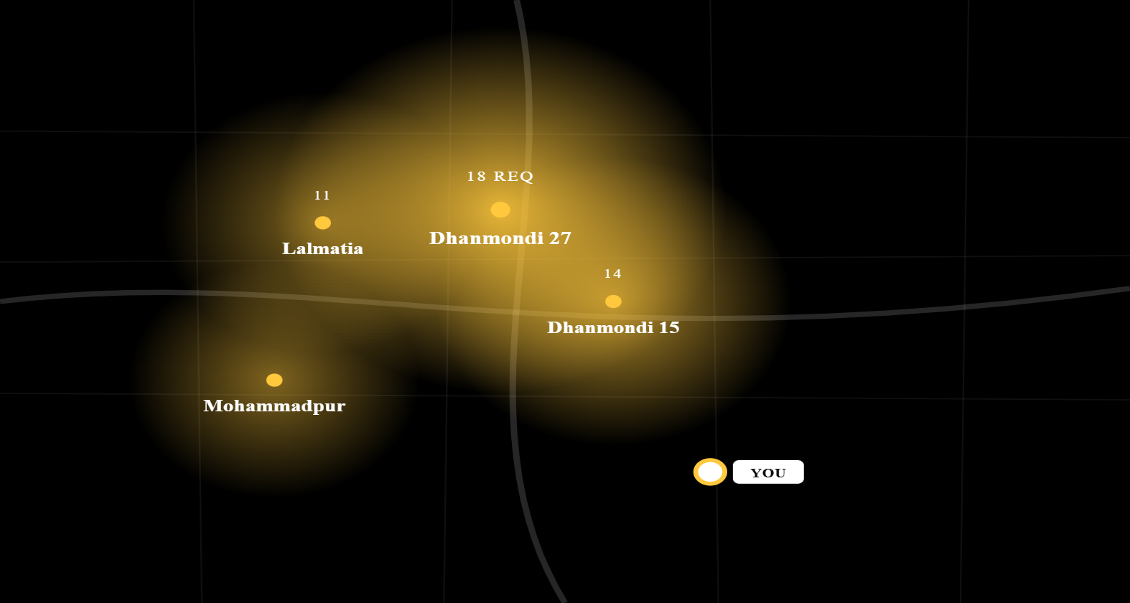
Tution.media
07 · DEMAND NEAR YOU
DEMAND-SIDE INTELLIGENCE
One data layer. Two audiences.
THIS WEEK · DHANMONDI CLUSTER
LIVE
Tutors see where requests cluster and which subjects are trending in real time — so they pick service areas that actually fill. Same heatmap drives ops decisions on where to acquire and where to run campaigns.
LIVE DENSITY
SUBJECT TRENDS
UNDER-SERVED POCKETS
CRM SIGNAL
71
14
৳8.7k
OPEN JOBS
IN YOUR AREAS
MEDIAN PAY
DEMAND INTELLIGENCE
07 / 14
Notes:
Demand near you is the tutor-facing heatmap. It tells a tutor where requests are clustering and which subjects are trending — so they pick service areas that maximize fill rate. Same data layer powers ops decisions.

Slide 8



Tution.media
08 · LOCATION PRIVACY
PRIVACY-CONTROLLED LOCATION REVEAL
A guardian's address is never exposed to strangers.
01 · POSTED
02 · REQUESTED
03 · UNLOCKED
Fuzzed publicly
One-tap approval
Exact pin + Google Maps
Tutors see area, landmark, and an approximate pin. Enough to estimate commute, not enough to find the home.
Guardian grants access to one tutor — or all shortlisted at once. Scoped to that single job.
Turn-by-turn navigation in-app. Auto-revoked if not hired. Logged for safety.
WHY IT MATTERS
Three features in one — safety, anti-leakage (navigation lives in-app), and a trust signal for anxious guardians.
LOCATION · PRIVACY
08 / 14
Notes:
Privacy-controlled location. A guardian's home address is never exposed to strangers — only fuzzed area + landmark, until they explicitly approve a tutor. On approval, exact pin and Google Maps navigation unlock.

Slide 9
Tution.media
09 · THE MOAT
ANTI-DISINTERMEDIATION
We don't lock you in. We make staying better than leaving.
Recurring auto-collection
Payment protection
Verified reputation
Removes the awkward monthly "please pay me" ask. Tutors get paid on time, every time.
Attendance-linked guarantee — only available on-platform. Cash deal? You're on your own.
Accrues from confirmed, paid tuitions. The asset they'd forfeit by going informal.
Replacement guarantee
Masked comms
Verified income proof
Not happy with the trial? Free replacement. Removes the default to the informal market.
No raw phone number exchange. Safety + anti-leakage in one mechanism.
Formal receipts the informal market can't produce. Basis for future lending products.
ANTI-DISINTERMEDIATION
09 / 14
Notes:
This is the moat. Auto-collected monthly payments, attendance-linked payment protection, verified reputation that only accrues on-platform, replacement guarantee, masked comms — every value layer is only available if you stay.

Slide 10
Tution.media
10 · ROADMAP
PHASING
Prove the loop. Then layer the moat.
V1 · MVP
NOW → Q3
V2 · MOAT
Q4 → 2027
V3 · SCALE
2027+
Prove the matching loop
Build the moat
Monetize deeper
Tutor: easy signup, live feed, 1-tap apply, tiers 0–2, basic reputation, masked chat. Guardian: post, applicants, shortlist, location grant, trial, digital agreement. Money: placement fee + trial/first month on-platform (habit seed).
Recurring auto-billing, wallet, escrow hold-and-release, payment protection, attendance → payment linkage, replacement guarantee, tutor tiers/levels, masked calling, progress reports, full demand heatmap.
Fintech: tutor income-based lending, guardian installments, tutor insurance. Verticals: English-medium, admission cramming, special needs. Formats: group, online, diaspora. B2B with coaching centers.
ROADMAP
10 / 14
Notes:
We are phased. V1 proves the matching loop in two Dhaka clusters. V2 builds the recurring rails — that's where the moat hardens. V3 layers fintech and verticals.

Slide 11
Tution.media
11 · REVENUE LINES
MONETIZATION, MAPPED TO PHASING
Six revenue lines. Three phases.
STAGE
REVENUE LINE
ENABLED BY
V1
Tutor placement fee
Matching + digital agreement
V1
Trial / first-month txn margin
Payment layer (lean)
V2
Recurring % of tuition (GMV)
On-platform recurring payments · the moat
V2
Payment-protection fee
Escrow + attendance linkage
V3
Lending / installment margin
Wallet + verified income data
V3
Premium verification, featured listings, B2B
Verification + ranking + scale
MONETIZATION
11 / 14
Notes:
Monetization maps cleanly to the phases. Placement fee in V1. Then GMV take rate and payment protection fees in V2. Eventually lending and B2B in V3.

Slide 12
Tution.media
12 · COLD START
COLD START · SUPPLY FIRST
Two clusters. Sequenced, not split.
SUPPLY PLAYBOOK
University CRM
BUET, DU, NSU, BRACU campus reps. Referral bonuses on first-completed-month. Manual onboarding calls — do things that don't scale.
DEMAND PLAYBOOK
Apartment building partnerships
Door-to-door in target clusters. Mother-of-mother referrals. Posters at coaching centers (frenemy strategy).
One area in DNCC, one in DSCC. We need tutor density before opening the demand floodgates. Hyperlocal liquidity is the whole game.
TARGET BY MONTH 6
1,200
350
DNCC · Dhanmondi cluster
MONTH 1
VERIFIED TUTORS
ACTIVE PLACEMENTS
DSCC · Dhanmondi-South extension
MONTH 4
Mirpur · Uttara · expansion
2027
GO-TO-MARKET
12 / 14
Notes:
Go to market is supply-first. Two areas — one in DNCC, one in DSCC — sequenced not split. We need tutor density before we open demand floodgates.

Slide 13
Tution.media
13 · INSTRUMENTATION
FROM DAY ONE
Measure the money flow, not just the match.
SUPPLY
LIQUIDITY
NORTH STAR
QUALITY
8.2k
4.3dys
63%
11mo
Tutor signups / mo
Time to confirm
On-platform GMV share
Median student retention
▲ 24% mom
▼ from 21 dys
INVERSE OF LEAKAGE
Incumbent: ~6 mo
Verification-completion rate
Applications per job
Recurring-payment retention
Tutor retention (12 mo)
Dispute rate
Referral rate · vs incumbent's 20%
INSTRUMENTATION
13 / 14
Notes:
Day one instrumentation. We measure on-platform GMV share — the inverse of leakage. That's the north-star number that tells us whether the moat is forming.

Slide 14
Tution.media
14 · CLOSE
WHY US · WHY NOW
We out-engineer 13 years of inertia by owning what the incumbent never bothered to.
ROUND SIZE
USE OF FUNDS
NEXT 6 MONTHS
$650k
Engineering
42%
· Ship V1 in 2 clusters
Ops & CRM
28%
· 1,200 verified tutors
18-month runway through V2 launch + 2 Dhaka clusters.
Marketing
18%
· 350 active placements
Payment / legal
12%
· Validate ৳-recurring pilot
LET'S TALK
founders@tution.media · +880 1712 048 391
CONFIDENTIAL · TUTION MEDIA
14 / 14
Notes:
Why us, why now. Android-first PWA, deep local insight, and the discipline to build the unsexy money rails the incumbent never bothered with.

